Slide 1

“Polarimetry of planetary systems”
A proposal for a novel integrated nano Wire Grid
Polarisers-based VNIR polarimeter for planetary studies from space
M. Focardi, M. Pancrazzi, F. Landini, M. Romoli, E. Pace
Mauro Focardi
INAF – Arcetri Astrophysical Observatory – Firenze, ITALY
e-mail: mauro@arcetri.astro.it
e-COST Conference - Firenze, 2013 September 25th

Slide 2
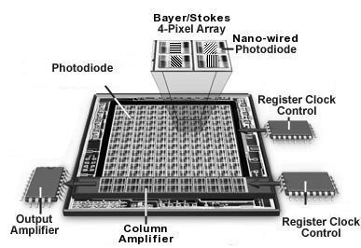


Contents
Introduction
Nano Wire Grid Polarisers (nano-WGPs)
Liquid Crystal Variable Retarders (LCVRs)
  LCVRs opto-mechanical mounting
  LCVRs driver electronics
WGPs + LCVRs based VNIR Polarimeter
  Theoretical basis
  The proposed integrated device
  Budgets, pro & contro
The way ahead
Conclusions
M. Focardi - e-COST Conference Firenze, 2013 September 25th

Slide 3
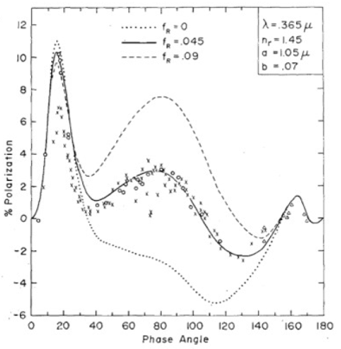
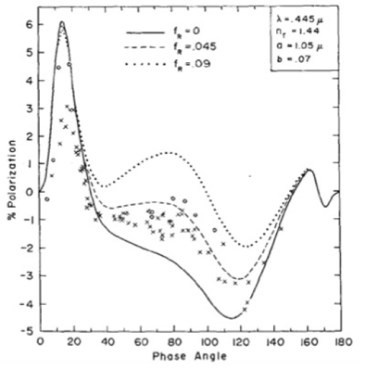
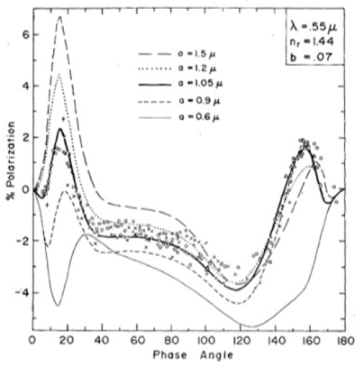
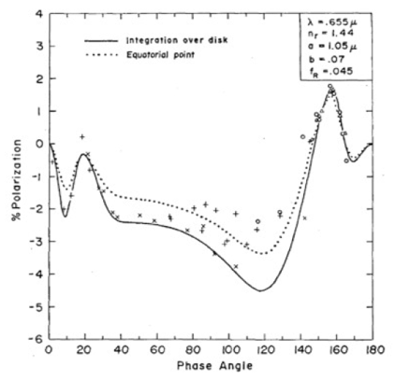
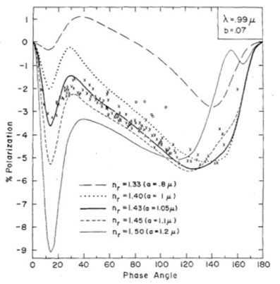
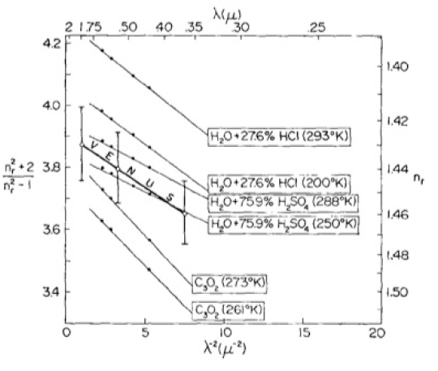
Introduction
ACTION MP1104
“Polarisation as a tool to study the Solar System and beyond”
Solar system
e.g. infer planets atmospheres composition.
Polarimetry of Venus
(Hansen & Hovenier, 1974)
Observations from ground.
Droplets of H₂SO₄ in the Venus atmosphere.
M. Focardi - e-COST Conference Firenze, 2013 September 25th

Slide 4
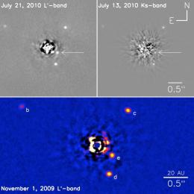
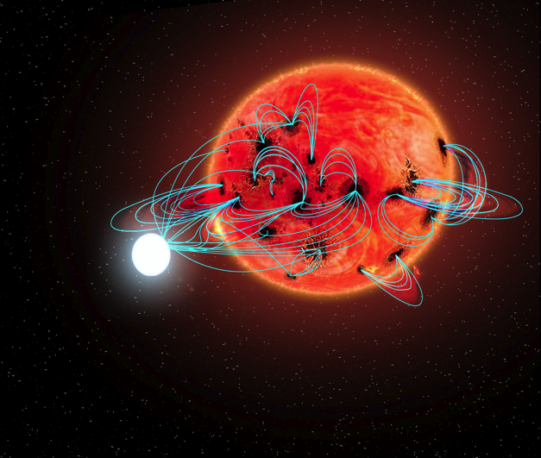

Introduction
ACTION MP1104
“Polarisation as a tool to study the Solar System and beyond”
Beyond solar system (e.g. exoplanets)
Collecting polarised radiation from the exoplanets (direct imaging with large collecting areas and coronagraphic techniques);
Collecting polarised radiation effects within spectra from the system star+planet (spectropolarimetry).
Stars hosting short period planets may have active regions caused by tidal or magnetic interactions between the star and planet
(Kuntz et al. 2000; Ip, Kopp, & Hu 2004).
Time-series spectropolarimetry
of cool stars (M type) with short period planets
can search for these effects
(Focardi et al., SPIE 2012).
B_{L}(Φ)
M. Focardi - e-COST Conference Firenze, 2013 September 25th

Slide 5
Introduction
O. Kochukhov &
N. Piskunov,
IAU Proceed. 2008
-> for 1-meter class telescope it is possible to reach a noise level of 10⁻³ in 1 hr of integration time for a mV ~ 5÷6 star -> quite compliant (e.g.) with EChO targets (mK ~4÷9) and hot Jupiters transit times
M. Focardi - e-COST Conference Firenze, 2013 September 25th

Slide 6
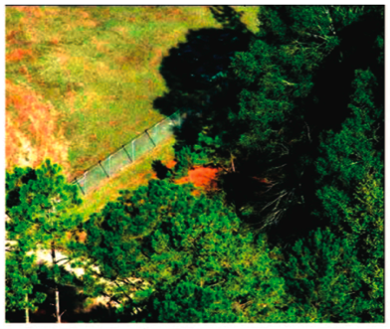
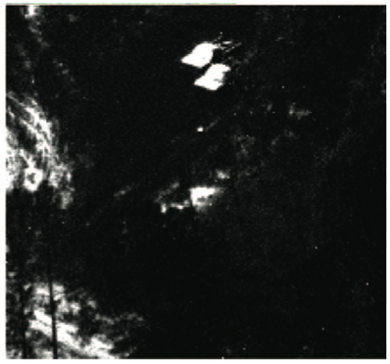
Introduction
The polarization state of radiation is represented in terms of the Stokes vector S = (I, Q, U, V)^{T}.
Multiple information are required to even partially characterize the polarization state of a scene.
Traditional methods collect these data acquiring multiple frames:
simultaneously by using separate cameras and detectors;
sequentially with a single detector.
M. Focardi - e-COST Conference Firenze, 2013 September 25th

Slide 7
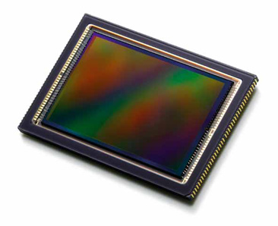
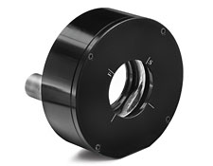
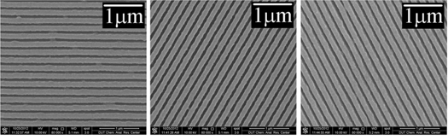
Introduction
Registration of multiple images is troublesome cause the need to correct either for temporal variation of the scene or, in case of simultaneous acquisition, for (e.g.) both mechanical and optical misalignment and the use of several detectors.
An ideal polarization analyser should be able to acquire simultaneously the required information in order to freeze, in a single snapshot, the polarization state of the target.
Furthermore the entire system should be as compact as possible (in volume and mass) and power saving (especially when used for space-based applications).
We aim at designing and developing a first prototype of a VNIR full-Stokes integrated polarimeter for planetary studies based on a CMOS detector with pixel covered by nano-Wire Grid Polarizers (WGPs) and a LCVRs acting as a variable retardance plate.
M. Focardi - e-COST Conference Firenze, 2013 September 25th

Slide 8
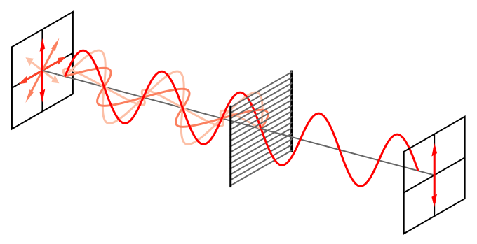
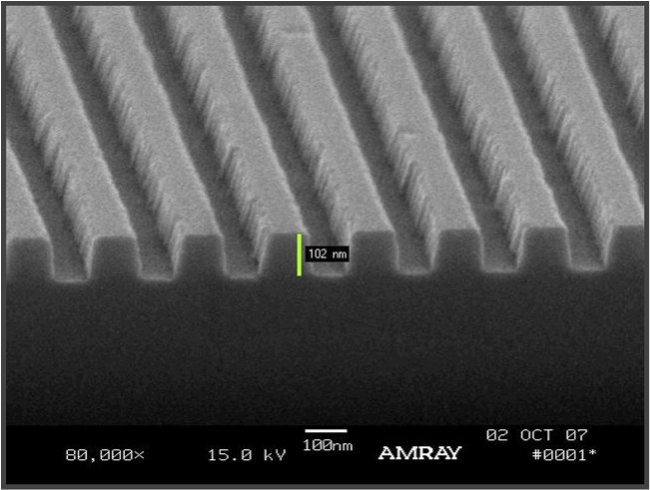
Wire Grid Polarisers
A WGP consists of a regular array of fine parallel metallic wires (e.g. Al), placed in a plane perpendicular to the incident beam.
The component of the electromagnetic waves with electric field aligned parallel to the wires is reflected by the WGP whereas the other component (electric field perpendicular to the wires) is transmitted.
Note: WGPs are efficient for λ ≥ 3 L_{pitch}.
Wire-grid based polarizers have been extensively used so far for ground-based application in the infrared and in the visible region. Now their usage should be extended to space…
M. Focardi - e-COST Conference Firenze, 2013 September 25th

Slide 9
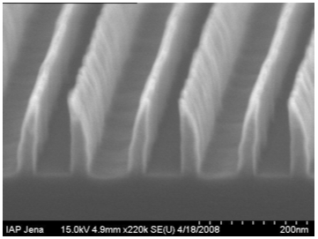
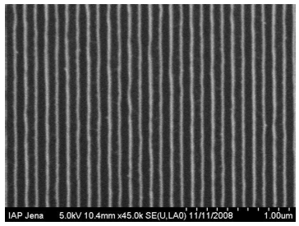
Wire Grid Polarisers
Recently, the remarkable improvement in nano pattern generation made by lithography techniques, (electrons beam or ions beam lift-off) brought the wire grid polarizers to have the potential to generate a broadband polarizer even in the UV range, where grids pitches are challenging.
Weber T. et al, “Wire-Grid Polarizer for the UV spectral region”, Proc. SPIE 7205 (2009).
M. Focardi - e-COST Conference Firenze, 2013 September 25th

Slide 10
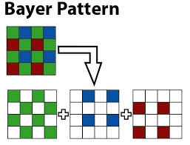
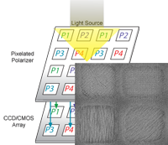
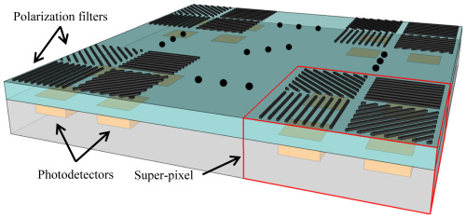
Wire Grid Polarisers
Borrowing the color-filter Bayer matrix concept, we aim at realizing an array of differently oriented (0°, 45°, 90°, 135°) nanowires WGPs matching the pixel array of a CMOS detector.
MOXTEX Inc.
We aim at the development of a mask organized in 2x2 pixels sub-array hosting at least 4 different nanowires-based “super pixels”. The 4 neighboring pixels, having different polarizing masks, enable the redundant collection of the 3 basic information (I, U, Q), necessary to obtain the linear polarization.
A first prototype, a CCD matrix of 1kx1k has been already produced to demonstrate the design feasibility and the alignment procedure (see V. Gruev et al, 2013) in the VNIR spectral range.
V. Gruev et. al, 2013.
M. Focardi - e-COST Conference Firenze, 2013 September 25th

Slide 11
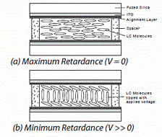
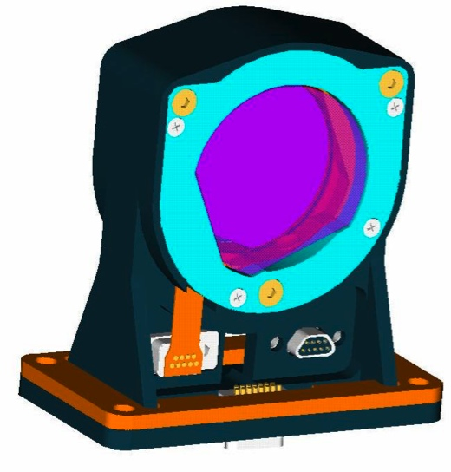
Liquid Crystal Variable Retarders
A “classical” polarimeter, in the easiest configuration, comprises a rotating quarter wave
plate and a fixed linear polarizer.
For the fully characterization of the linear polarization the knowledge of the I, Q and U parameters is needed. For that reason at least 3 measurements in a 3 different positions (or retardances) of the quarter wave plate are required.
The Liquid Crystal -based retarder (LCVR) acts as a variable retarder.
The variation in retardance is introduced by the variation of birefringence that change with the alignment of the liquid crystals sensible to an applied electric field. By the application of calibrated external voltages, different retardances values are immediately set without using moving mechanical parts.
This is one of the most relevant advantages on the use of this technology, especially for their use in space .
M. Focardi - e-COST Conference Firenze, 2013 September 25th

Slide 12
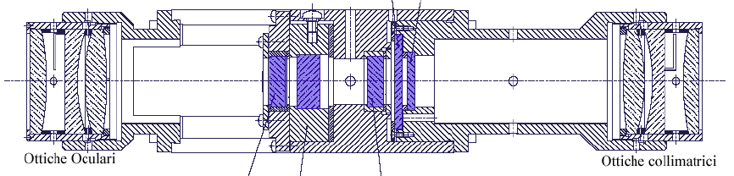
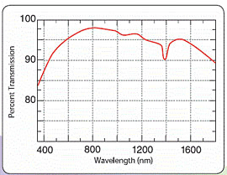
LCVRs mounting
LCVRs are often used in a telecentric opto-mechanical mount like that represented hereafter:
Camera lens group
Collimating optics
Detector
VNIR light
LCVRs + passband filter assembly
LCVRs are achromatic only on small bandwidths of the order of tens of nm;
They need to be stabilised in temperature to present a reproducible and stable response in retardance.
M. Focardi - e-COST Conference Firenze, 2013 September 25th

Slide 13
LCVRs drivers
LCVRs are controlled by voltage amplitude modulated signals (2 kHz typically):
ELECTRONICS DRIVER BOARD
FPGA
Power
Fine
Reg.
N bits
Dec./C.I.
+ FSM
Commands
2 kHz
Voltage levels
selection (Ampl. 1-4)
DAC V+
DAC V-
Heaterpower
switch
CMOS Quad Analog switch
Analog switch
Buffer
Liquid Cristal Variable Retarder (LCVR)
Voltages amplitude modulation
Heater; Temperature control (+/- 1°C)
+10 V
-10 V
M. Focardi - e-COST Conference Firenze, 2013 September 25th

Slide 14
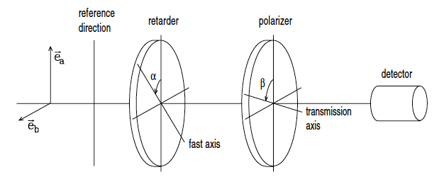
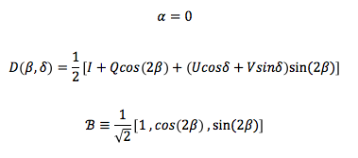
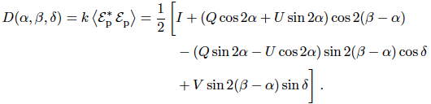
LCVRs + WGPs assembly
LCVR
WGPs
CMOS
Courtesy:
E. Landi Degl’Innocenti
“Polarization in Spectral Lines” book.
-> 2 measurements (2 δ “complementary” values) to infer the full Stokes vector S = (I, Q, U, V)^{T}
M. Focardi - e-COST Conference Firenze, 2013 September 25th

Slide 15
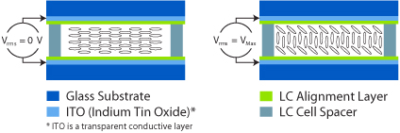
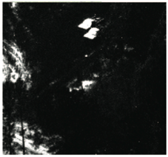
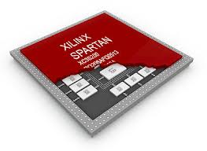

The integrated device
LCVRs
(telecentric mount)
LCVR
control
Post
processing
FPGA
CMOS control
& data acq.
On-board
processing
M. Focardi - e-COST Conference Firenze, 2013 September 25th

Slide 16
Budgets
The LCVRs+WGP+CMOS assembly is particularly suitable for using it in space applications
for many reasons:
Reduced power consumption ( < 2÷3 W for the whole assembly, detector and control FPGA included);
Reduced mass (< 1 kg for the whole assembly);
Reduced volume (substantially the optics volume);
Low overall complexity;
Good efficiency ~80% (LCVRs + WGPs) ;
Large extinction ratio (> 1000:1) in the VNIR (WGPs);
No mechanical moving parts (electro-modulated device);
Capability to host the embedded electronics for the overall assembly control and signal pre-processing;
Reduced needs for the platform on-board (S/C) data processing electronics.
Drawbacks:
Needs for a thermal control electronics (T sensors, heathers, etc.);
LCVRs are achromatic (reduced wavelength bandpass and throughput);
Nano-WGPs have yet to be qualified for space applications while LCVRs were qualified by INTA for the Solar Obiter payload (PHI, METIS);
Needs for calibrations and special care to avoid instrumental residual polarisation (optics birifr., FPN, etc.).
M. Focardi - e-COST Conference Firenze, 2013 September 25th

Slide 17
The way ahead
Presently our group aim at the development of a first prototype matrix of 2 x 2 super pixels (4 sub-arrays) with WGPs pitches up to ~40 nm in order to demonstrate the design feasibility and the alignment procedure for a VUV linear polarimeter for Heliophysics studies;
Extension of the nano-WGPs + CMOS operability down to VUV (HI Ly-alpha @ 121 nm) in collaboration with ICFO Nanophotonics Laboratory in Barcelona, Spain (see M. Pancrazzi and M. Focardi Helsinki e-COST meeting presentations);
To get this goal and collect funds we presented a FIRB (“Future In Research”) project to the italian MIUR. The project was organized in 3 years and it was intended to provide intermediate results year by year, but …
… the FIRB project was submitted on February 2013; it passed a first selection obtaining a good judgment (9.67/10) but was refused by MIUR just last week (13.67/15) ☹.
M. Focardi - e-COST Conference Firenze, 2013 September 25th

Slide 18
Conclusions
There are several Astronomy fields that would take advantage from the development of a CMOS sensor with an integrated LCVRs + WGPs polarimeter (Planetary studies, Solar Physics, …);
Such a device would be particularly suitable to be hosted by space instrumentation where mass, volume and power budget are restrictive constraint to deal with;
A VUV CMOS integrated polarimeter could be profitably used to study fast evolving astrophysical processes such as plasma diagnostic or Sun-Earth weather relationships based on coronal plasma observations and to the study of the Solar Corona (electron densities, etc…).
M. Focardi - e-COST Conference Firenze, 2013 September 25th

